Slide 1
DESIGN PATTERN
ALGORITMA PEMROGRAMAN II
Bayu Rimba Pratama, ST, M.Kom

Slide 2
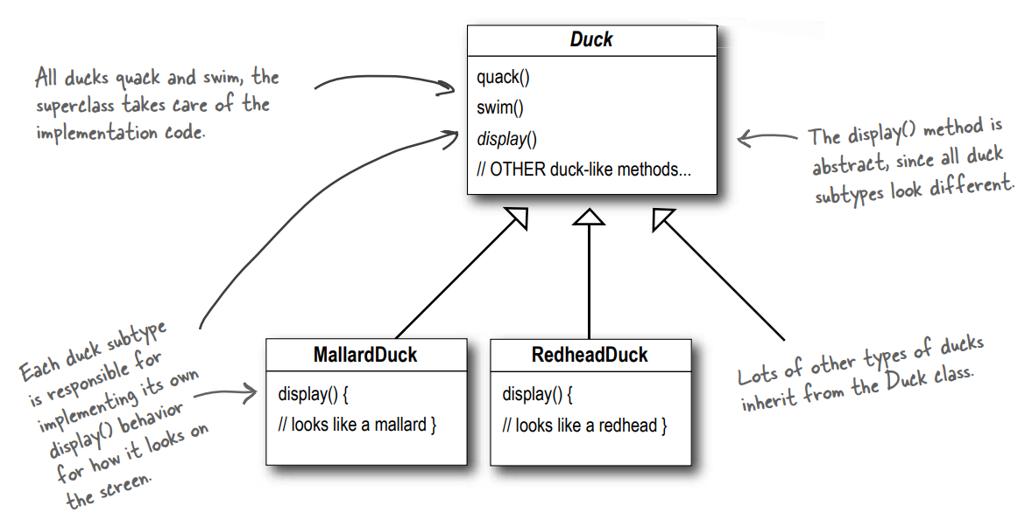
It started with a simple SimUDuck app
Joe works for a company that makes a highly successful duck pond simulation game, SimUDuck. The game can show a large variety of duck species swimming and making quacking sounds. The initial designers of the system used standard OO techniques and created one Duck superclass from which all other duck types inherit.

Slide 3
It started with a simple SimUDuck app
In the last year, the company has been under increasing pressure from competitors. After a week long off-site brainstorming session over golf, the company executives think it’s time for a big innovation. They need something really impressive to show at the upcoming shareholders meeting in Maui next week.
The executives decided that flying ducks is just what the simulator needs to blow away the other duck sim competitors. And of course Joe’s manager told them it’ll be no problem for Joe to just whip something up in a week. “After all”, said Joe’s boss, “he’s an OO programmer... how hard can it be?”

Slide 4
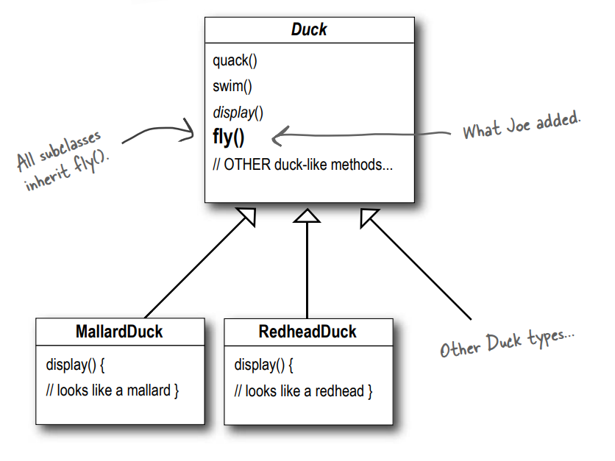
It started with a simple SimUDuck app
“I just need to add a fly() method in the Duck class and then all the ducks will inherit it. Now’s my time to really show my true OO genius” – says Joe.

Slide 5
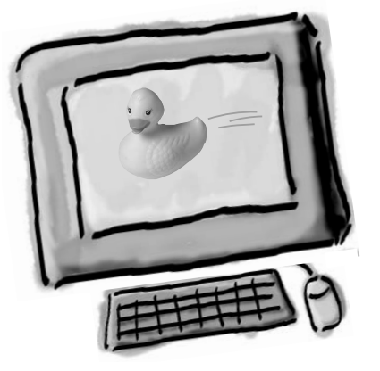

But something went horribly wrong...
Joe, I’m at the shareholder’s meeting. They just gave a demo and there were rubber duckies flying around the screen. Was this your idea of a joke? You might want to spend some time on Monster.com...

Slide 6
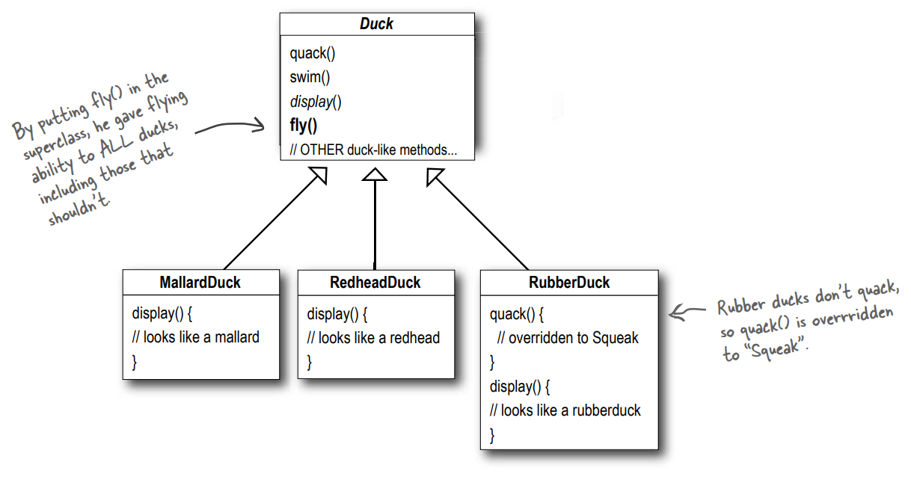
What happened?
Joe failed to notice that not all subclasses of Duck should fly. When Joe added new behavior to the Duck superclass, he was also adding behavior that was not appropriate for some Duck subclasses. He now has flying inanimate objects in the SimUDuck program

Slide 7
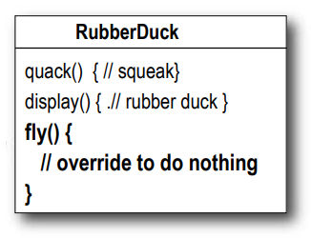
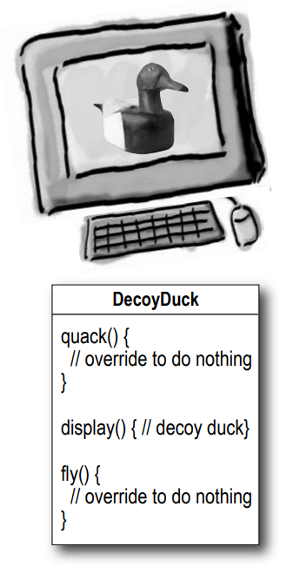
Joe thinks about inheritance...
I could always just override the fly() method in rubber duck, the way I am with the quack() method..
But then what happens when we add wooden decoy ducks to the program? They aren’t supposed to fly or quack...

Slide 8
How about an interface?
Joe realized that inheritance probably wasn’t the answer, because he just got a memo that says that the executives now want to update the product every six months (in ways they haven’t yet decided on). Joe knows the spec will keep changing and he’ll be forced to look at and possibly override fly() and quack() for every new Duck subclass that’s ever added to the program… forever.
So, he needs a cleaner way to have only some (but not all) of the duck types fly or quack.

Slide 9
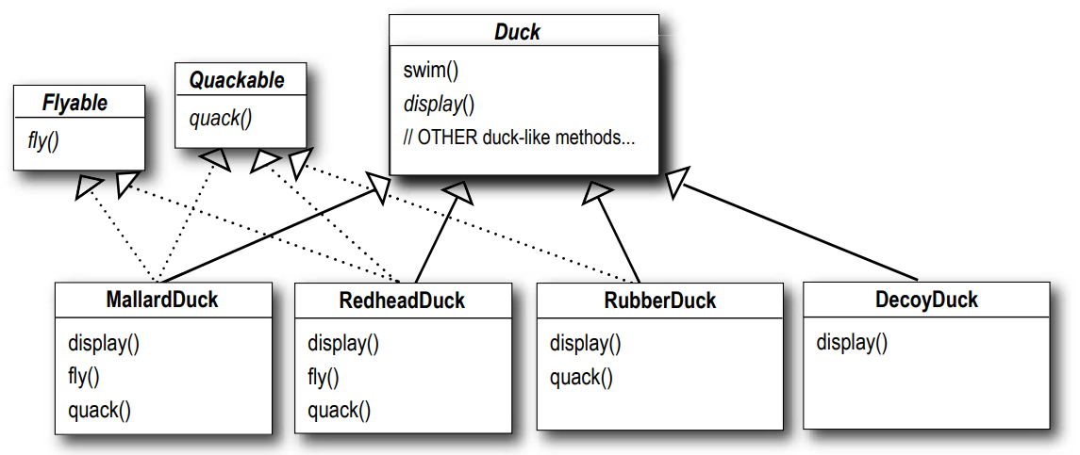
What do YOU think about this design?
I could take the fly() out of the Duck superclass, and make a Flyable() interface with a fly() method. That way, only the ducks that are supposed to fly will implement that interface and have a fly() method... and I might as well make a Quackable, too, since not all ducks can quack.

Slide 10
What would you do if you were Joe?
If you thought having to override a few methods was bad, how are you gonna feel when you need to make a little change to the flying behavior... in all 48 of the flying Duck subclasses?!
We know that not all of the subclasses should have flying or quacking behavior, so inheritance isn’t the right answer. But while having the subclasses implement Flyable and/or Quackable solves part of the problem (no inappropriately flying rubber ducks), it completely destroys code reuse for those behaviors, so it just creates a different maintenance nightmare.

Slide 11
The one constant in software development
No matter where you work, what you’re building, or what language you are programming in, what’s the one true constant that will be with you always?
CHANGE
No matter how well you design an application, over time an application must grow and CHANGE or it will die
Wouldn’t it be dreamy if only there were a way to build software so that when we need to CHANGE it, we could do so with the least possible impact on the existing code? We could spend less time reworking code and more making the program do cooler things.

Slide 12
Zeroing in on the problem...
So we know using inheritance hasn’t worked out very well, since the duck behavior keeps changing across the subclasses, and it’s not appropriate for all subclasses to have those behaviors
The Flyable and Quackable interface sounded promising at first… but whenever you need to modify fly or quack behavior, you’re forced to track down and change it in all the different subclasses where that behavior is defined, probably introducing new bugs along the way!
Here’s another way to think about this principle: take the parts that vary and encapsulate them, so that later you can alter or extend the parts that vary without affecting those that don’t.

Slide 13
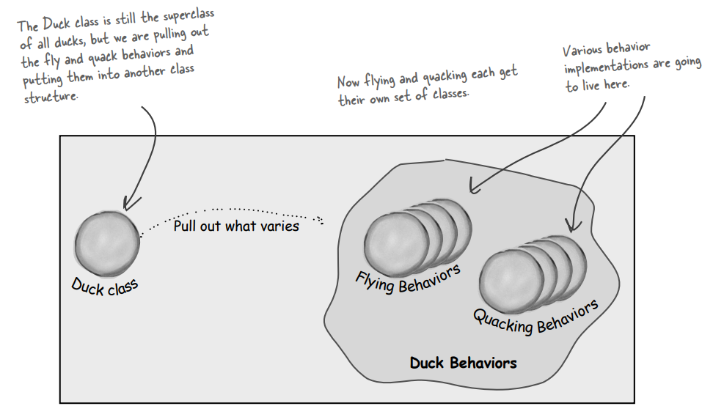
Zeroing in on the problem...
We know that fly() and quack() are the parts of the Duck class that vary across ducks.
To separate these behaviors from the Duck class, we’ll pull both methods out of the Duck class and create a new set of classes to represent each behavior.

Slide 14
Designing the Duck Behaviors
So how are we going to design the set of classes that implement the fl y and quack behaviors?
We’ll use an interface to represent each behavior – for instance, FlyBehavior and QuackBehavior – and each implementation of a behavior will implement one of those interfaces.
So this time it won’t be the Duck classes that will implement the flying and quacking interfaces. Instead, we’ll make a set of classes that will implement the behavior interface

Slide 15
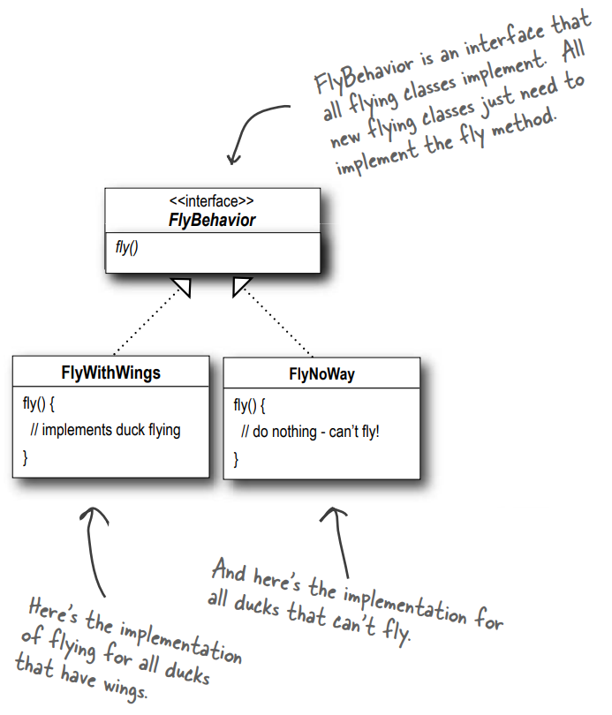
Designing the Duck Behaviors
From now on, the Duck behaviors will live in a separate class—a class that implements a particular behavior interface.
That way, the Duck classes won’t need to know any of the implementation details for their own behaviors.

Slide 16
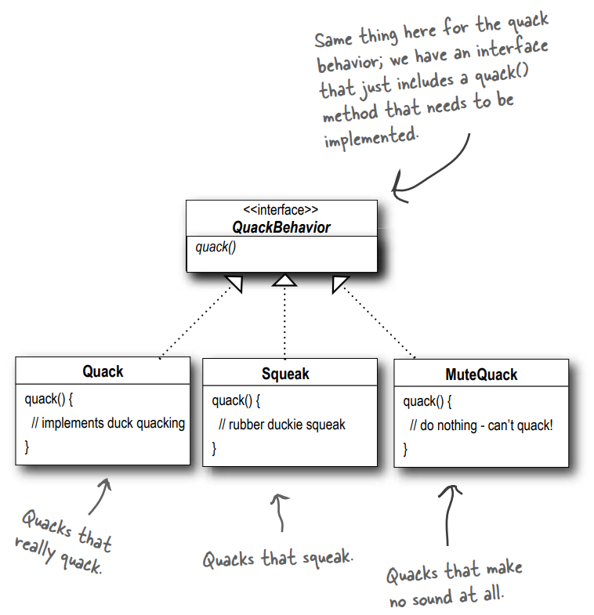
Designing the Duck Behaviors
With this design, other types of objects can reuse our fly and quack behaviors because these behaviors are no longer hidden away in our Duck classes
And we can add new behaviors without modifying any of our existing behavior classes or touching any of the Duck classes that use flying behaviors

Slide 17
Integrating the Duck Behavior
The key is that a Duck will now delegate its flying and quacking behavior, instead of using quacking and flying methods defined in the Duck class (or subclass).
Here’s how:
First we’ll add two instance variables to the Duck class called flyBehavior and quackBehavior, that are declared as the interface type (not a concrete class implementation type). Each duck object will set these variables polymorphically to reference the specific behavior type it would like at runtime (FlyWithWings, Squeak, etc.)
We’ll also remove the fly() and quack() methods from the Duck class (and any subclasses) because we’ve moved this behavior out into the FlyBehavior and QuackBehavior classes
We’ll replace fly() and quack() in the Duck class with two similar methods, called performFly() and performQuack();

Slide 18
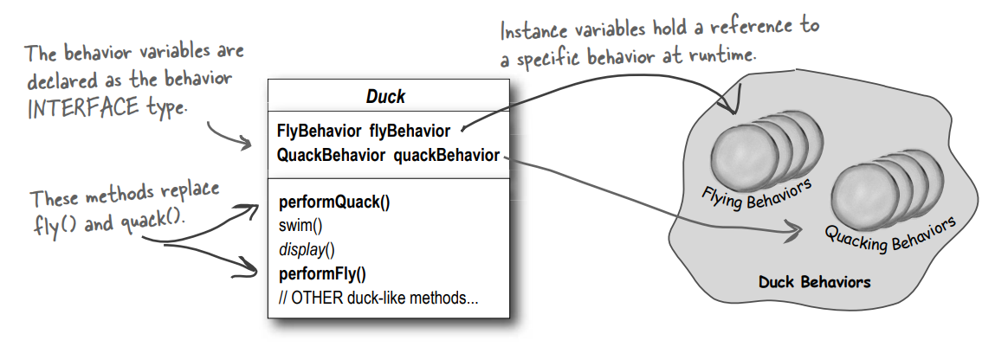
Integrating the Duck Behavior

Slide 19
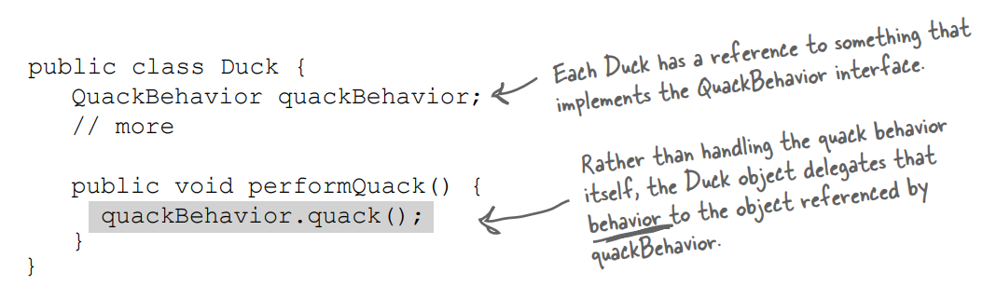
Integrating the Duck Behavior
Second, we implement performQuack():
Pretty simple, huh? To perform the quack, a Duck just allows the object that is referenced by quackBehavior to quack for it. In this part of the code we don’t care what kind of object it is, all we care about is that it knows how to quack()!
Third, time to worry about how the flyBehavior and quackBehavior instance variables are set. Let’s take a look at the MallardDuck class.

Slide 20
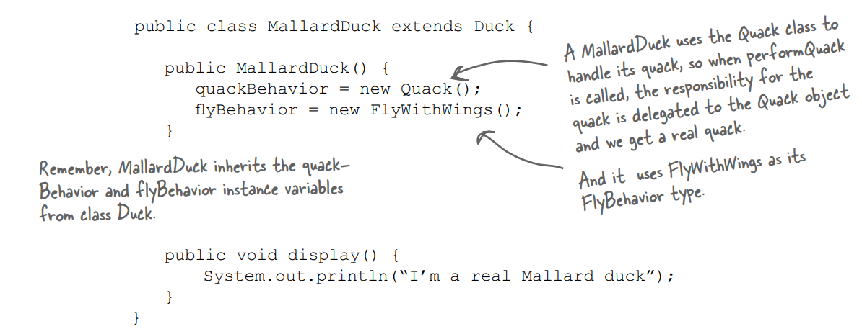
Integrating the Duck Behavior
So MallardDuck’s quack is a real live duck quack, not a squeak and not a mute quack. So what happens here? When a MallardDuck is instantiated, its constructor initializes the MallardDuck’s inherited quackBehavior instance variable to a new instance of type Quack.
And the same is true for the duck’s flying behavior.

Slide 21
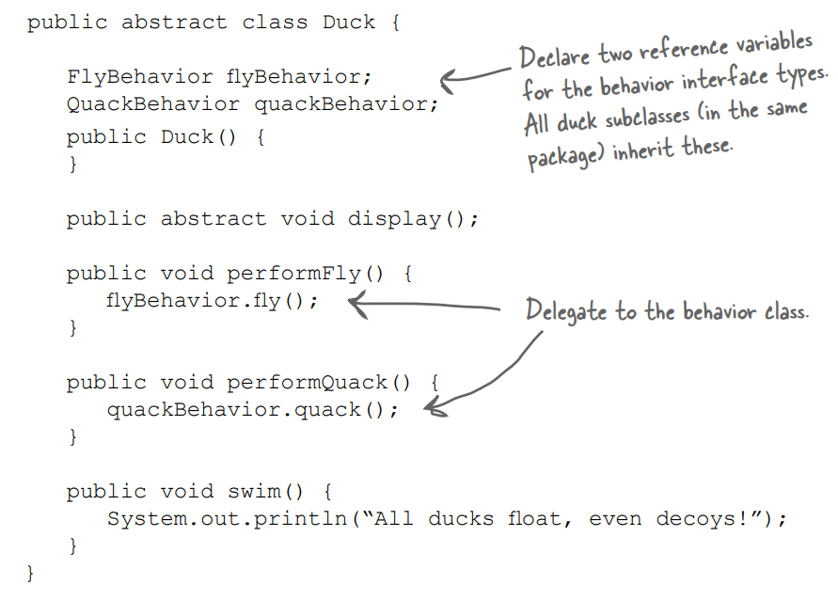
abstract class Duck

Slide 22
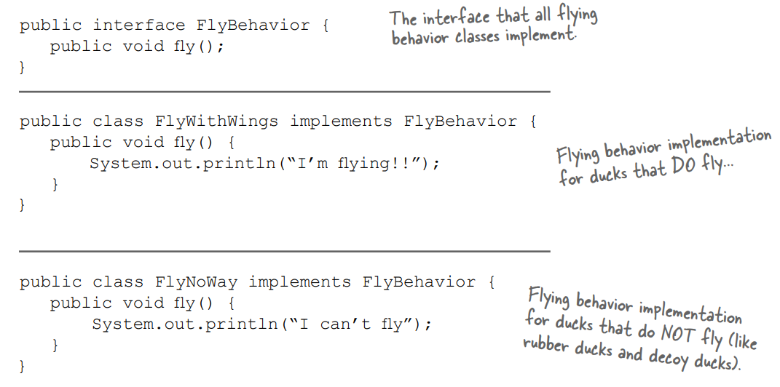
Interface FlyBehavior

Slide 23
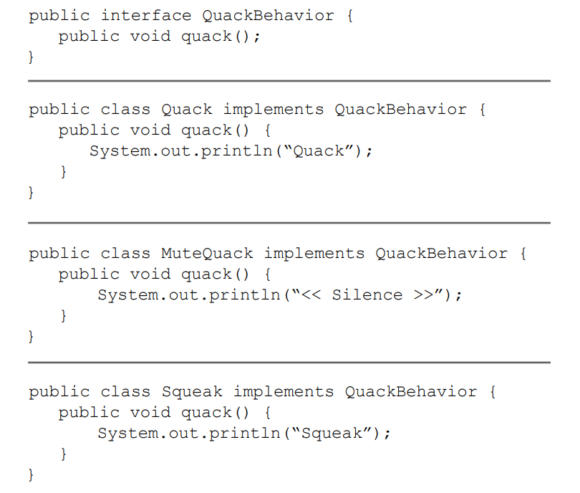
Interface QuackBehavior

Slide 24
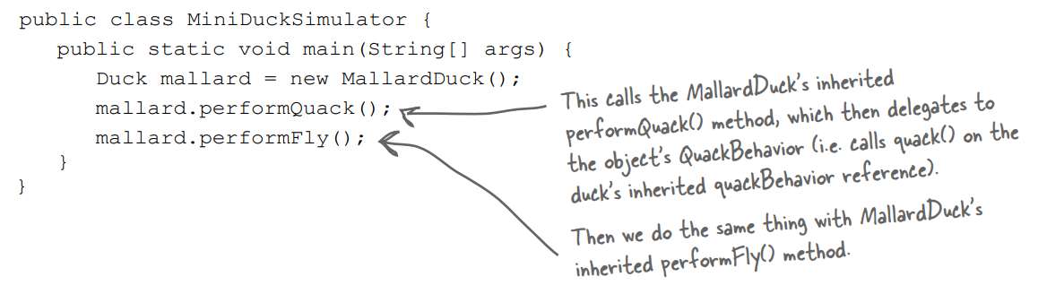
Main Program

Slide 25
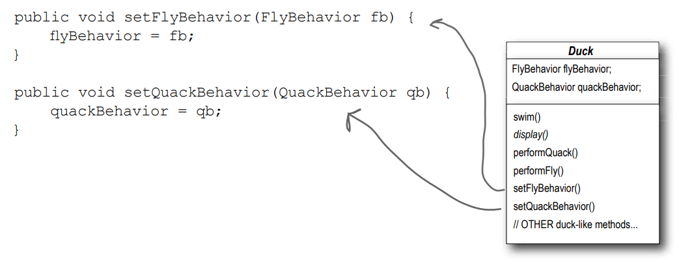
Setting behavior dynamically
What if we want to change a duck’s behavior at runtime? Answer is: just call the duck’s setter method for that behavior.

Slide 26
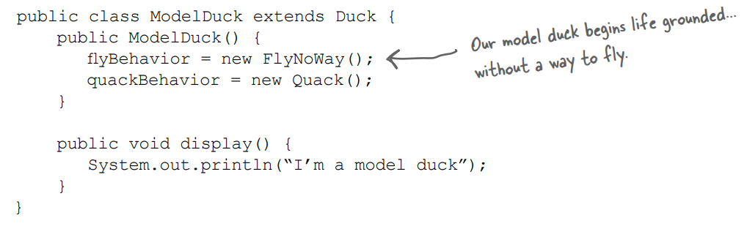
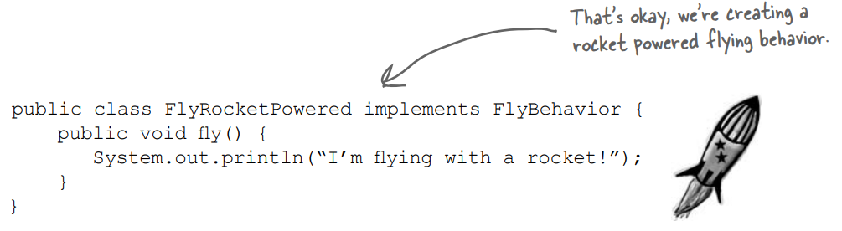
Setting behavior dynamically
Example of setting behavior dynamically:
Make a new Duck type (ModelDuck.java).
Make a new FlyBehavior type

Slide 27
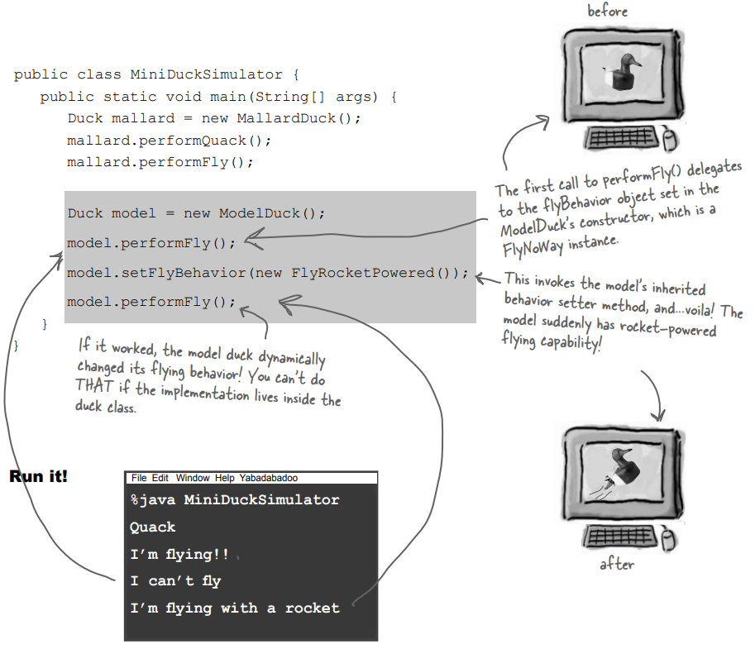
Setting behavior dynamically

Slide 28
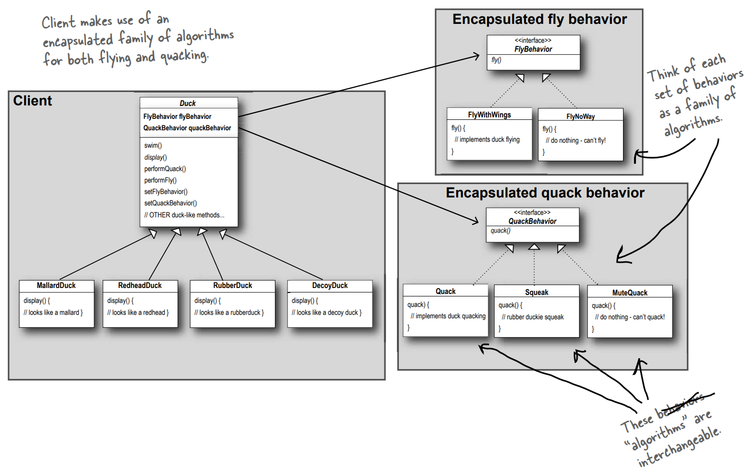
The Final form of Class Diagram

Slide 29
HAS-A can be better than IS-A
The HAS-A relationship is an interesting one: each duck has a FlyBehavior and a QuackBehavior to which it delegates flying and quacking
When you put two classes together like this you’re using composition. Instead of inheriting their behavior, the ducks get their behavior by being composed with the right behavior object
As you’ve seen, creating systems using composition gives you a lot more flexibility. Not only does it let you encapsulate a family of algorithms into their own set of classes, but it also lets you change behavior at runtime as long as the object you’re composing with implements the correct behavior interface
Composition is used in many design patterns and you’ll see a lot more about its advantages and disadvantages throughout the book

Slide 30
Speaking of Design Patterns...
You are just applied your first Design Pattern:
STRATEGY pattern
The Strategy Pattern defines a family of algorithms, encapsulates each one, and makes them interchangeable. Strategy lets the algorithm vary independently from clients that use it.

Slide 31
Thank You
Bayu Rimba Pratama, ST, M.Kom
bayuforest@gmail.com

